Slide 1
Software Quality Assurance and Testing Technology
1st Semester, Fall 2022
Xiaoping CHE (xpche@bjtu.edu.cn)
Associate Professor
School of Software Engineering
Beijing Jiaotong University

Slide 2
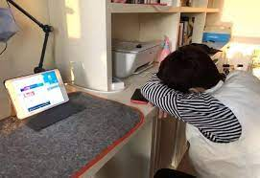






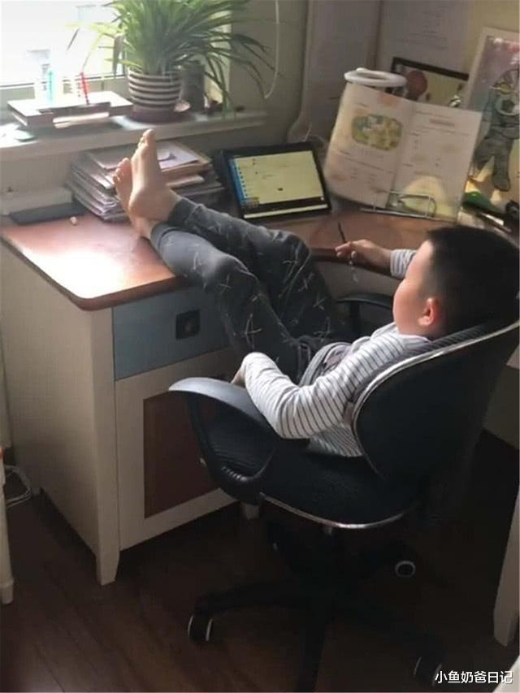
Rules

Slide 3
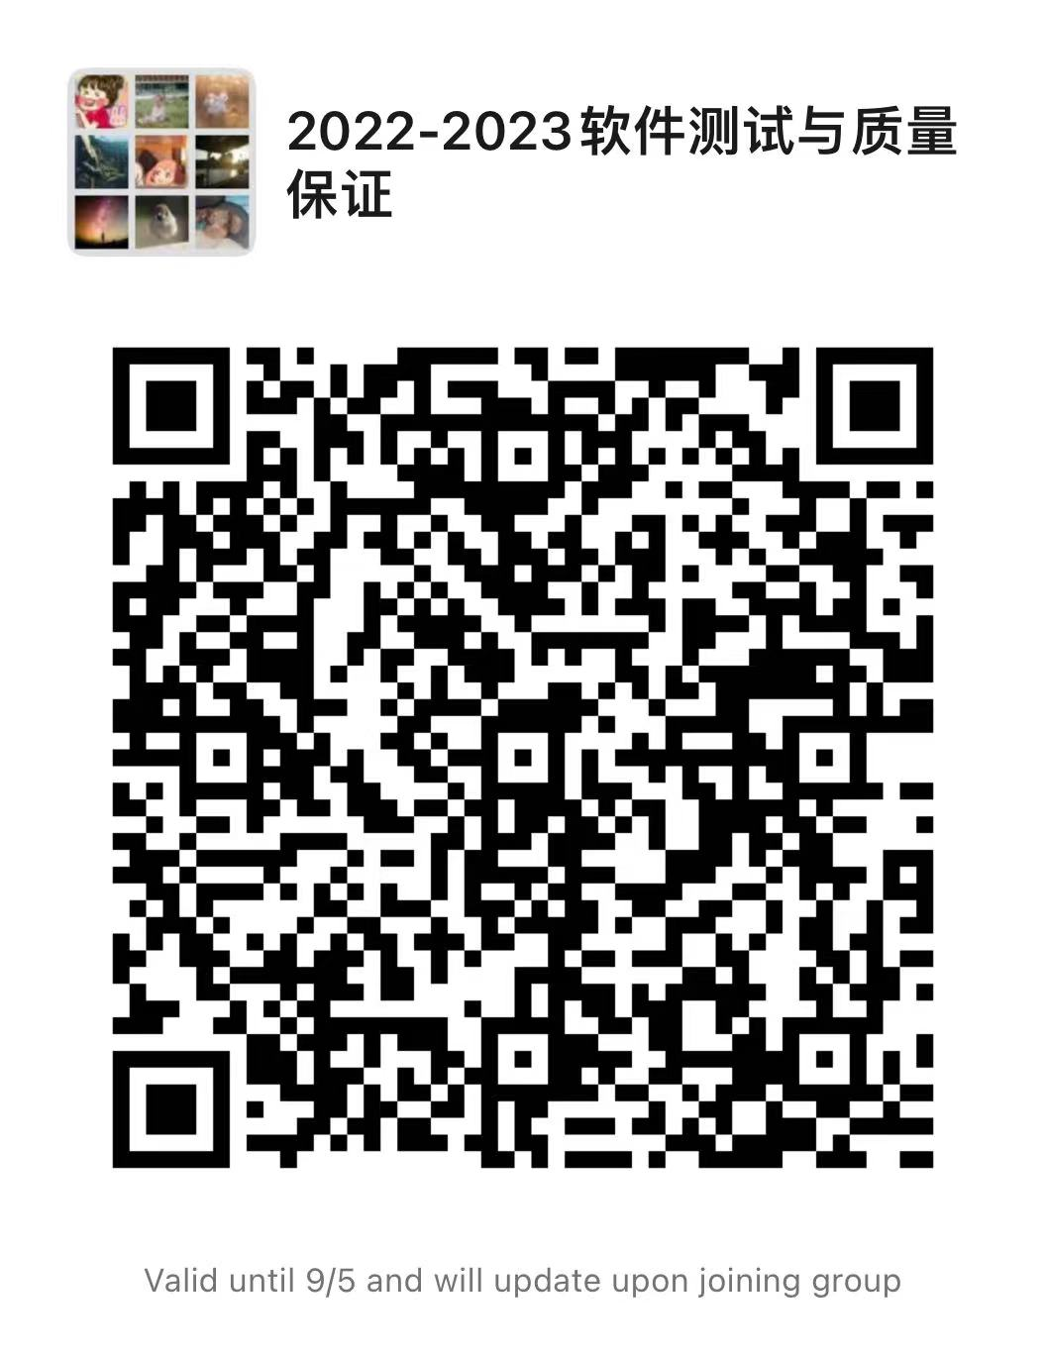
Rules

Slide 4
Rules
Project 20%
Assignments 40%
Final Exam 40%

Slide 5
How
16 Weeks Plan
Week 1: The basic concepts and theories of testing
Week 2-3: Principles of Testing
Week 4-5: Requirements and test case management
Week 6-7: Design of Test Cases
Week 8: Unit Testing
Week 9: Integration Testing
Week 10-11: System Testing
Week 12: Regression Testing
Week 13-14: Software Testing Management
Week 15: International and Local Testing
Week 16: Future of Testing

Slide 6





How
References
Ron Patton, Software Testing (2th Edition)
Glenford J. Myers, The Art of Software Testing (3rd Edition)
Gerald M. Weinberg, Perfect Software

Slide 7
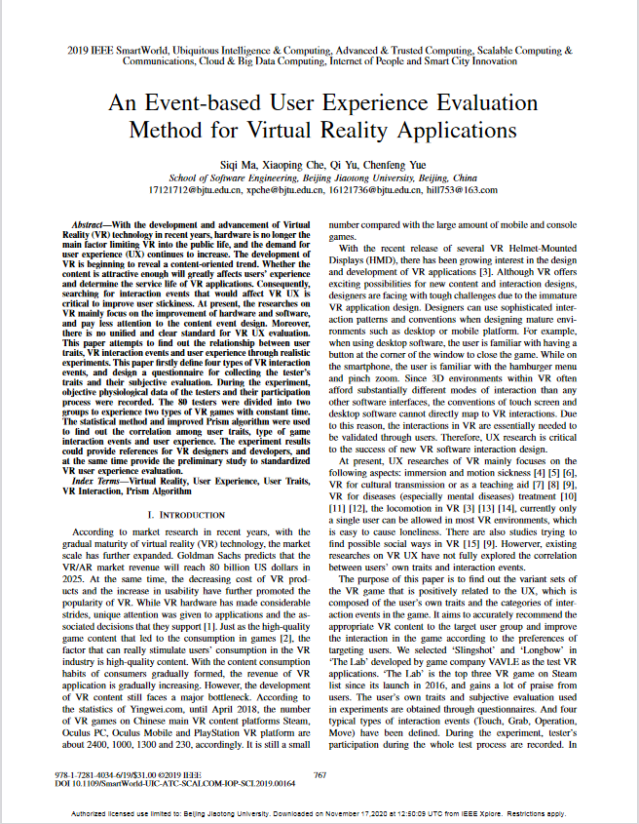
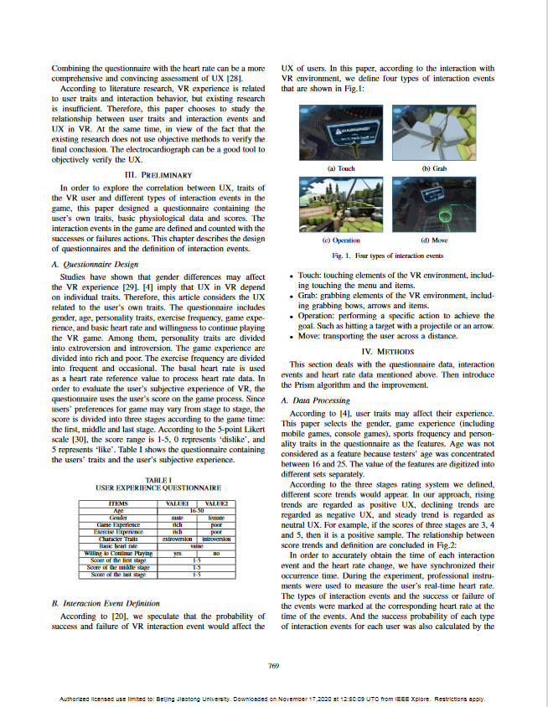
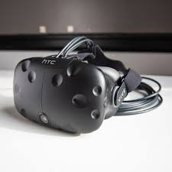
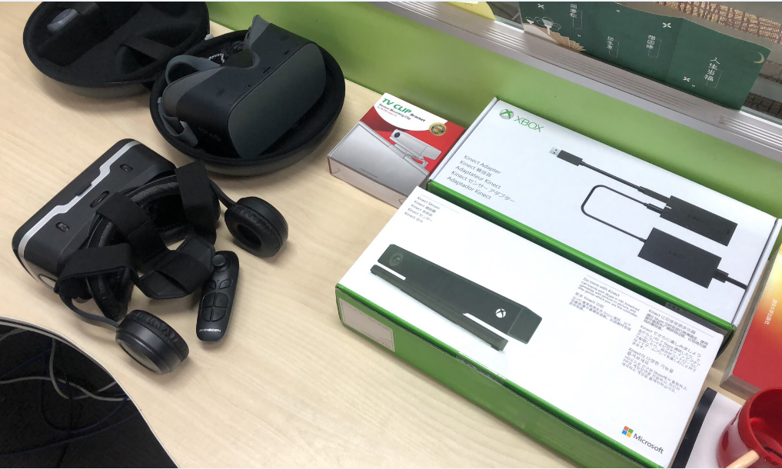
Extra Rules
Keywords:
Testing; Virtual Reality;
User Experience;
Human Computer Interaction;
A technical paper 96%- 100%
Requirements: English, 6 pages, Double Column, Original
A free ticket to attend a conference in China/Foreign Country.

Slide 8
What is Testing
Software testing is a process, or a series of processes, designed to make sure computer code does what it was designed to do and, conversely, that it does not do anything unintended.
System
Input
Output

Slide 9
Test Cycle
Test
cases
Execution of cases
Additional tests
Results
Suspected causes
Regression tests
Evaluation
Corrections
Identified causes
Debugging

Slide 10
What is Testing
Level of detail
system
integration
module
unit
security
Accessibility
robustness
white box
black box
performance
usability
reliability
functional behaviour
Characteristics

Slide 11
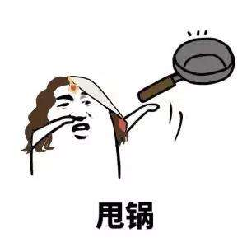
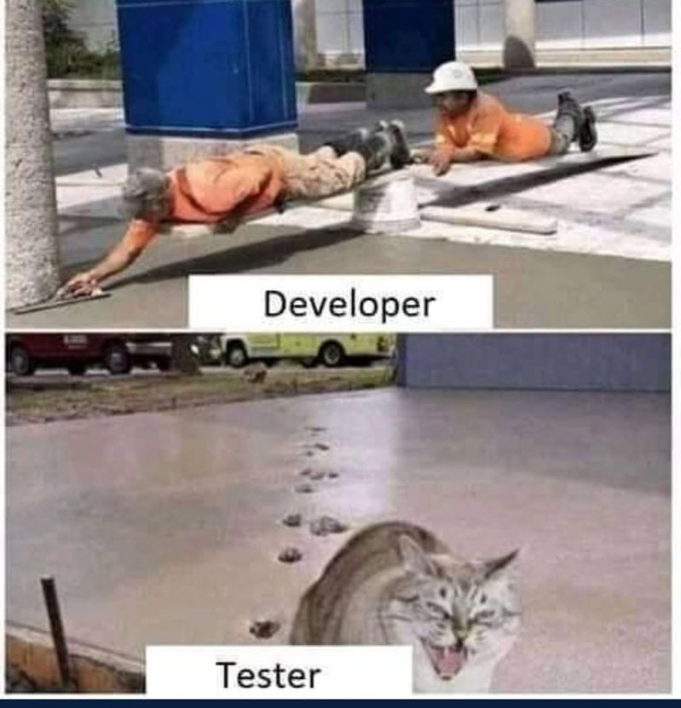
Developer and Tester
People are really hard to admit that they are wrong !

Slide 12
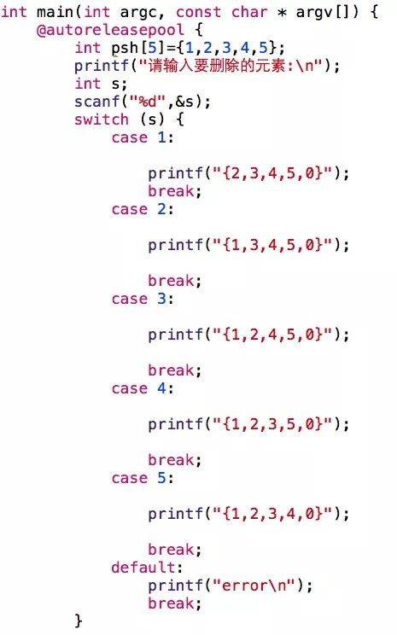
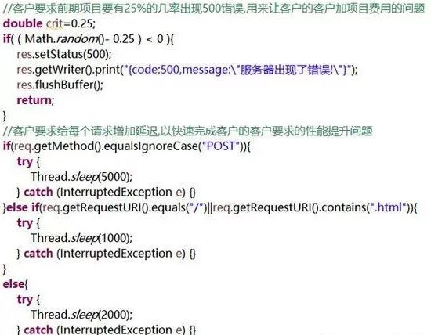
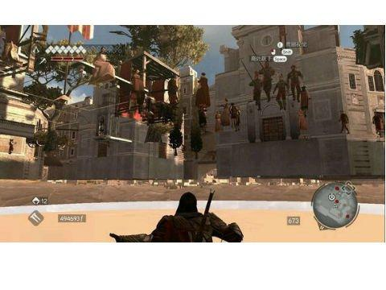
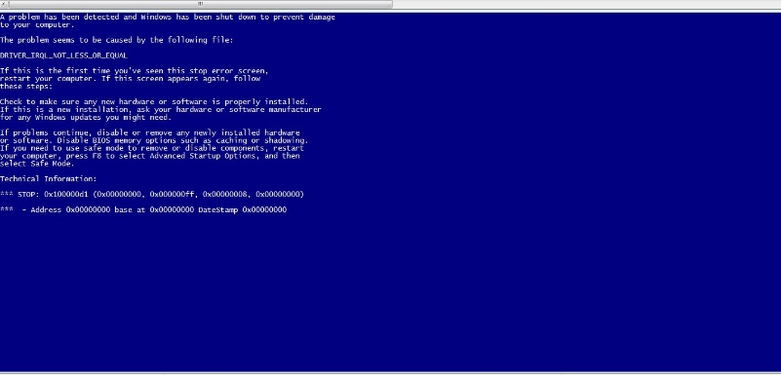
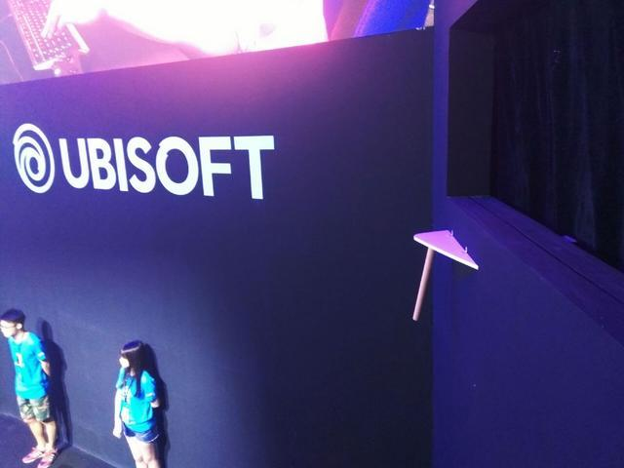
Why

Slide 13
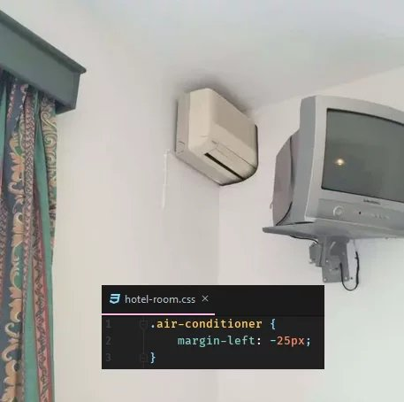
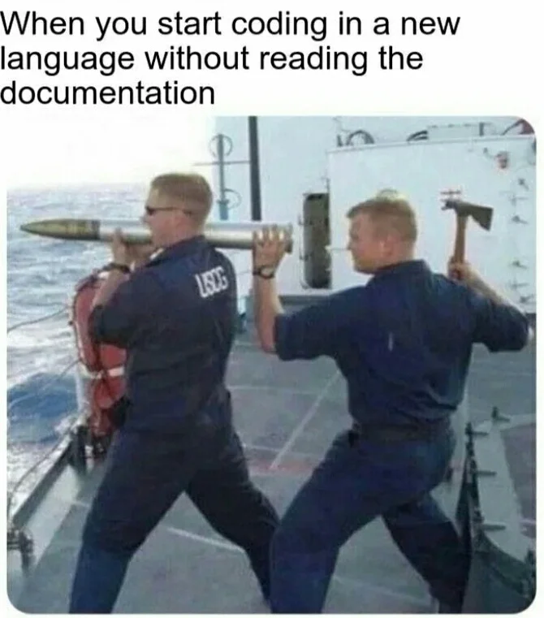
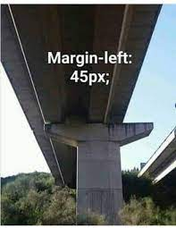
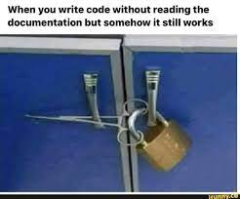
Why

Slide 14
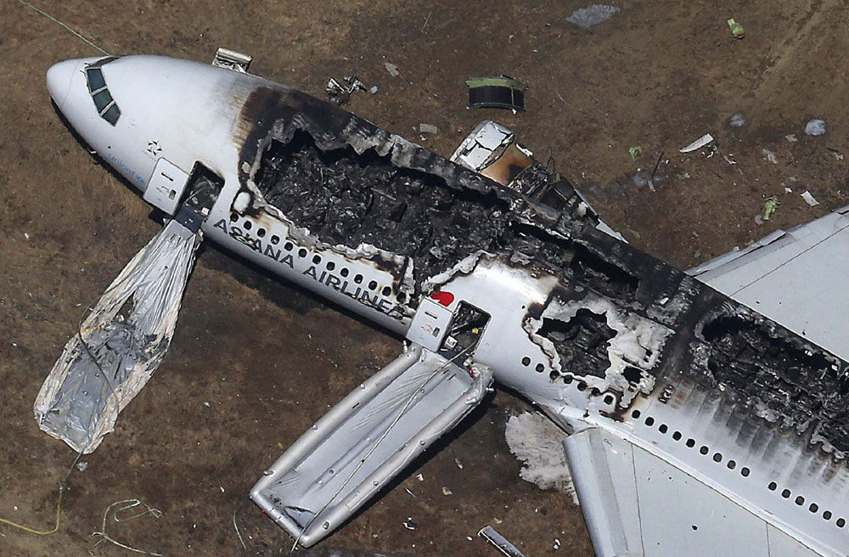
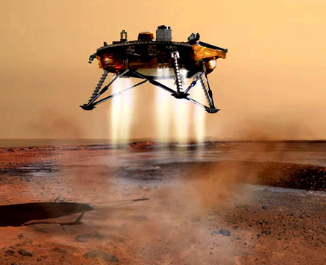


Why

Slide 15

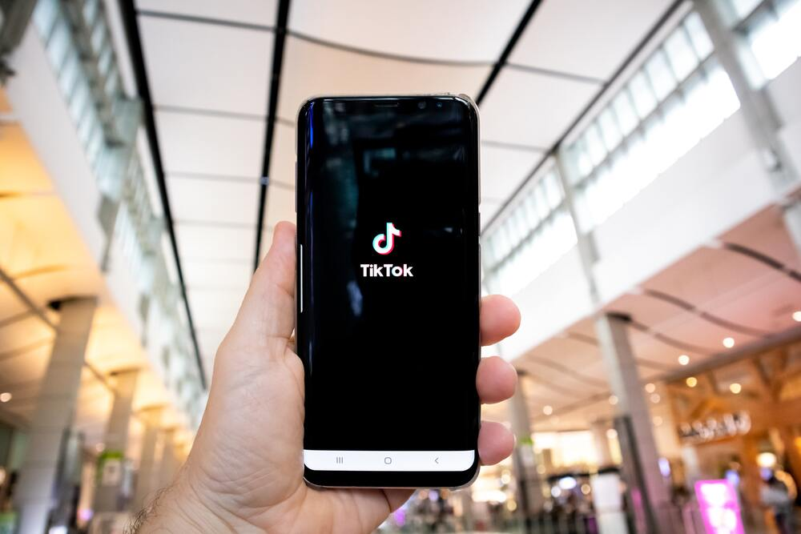
Why
On March 18, 2021, a bad actor illegally accessed and acquired personal data from T-Mobile customers. T-Mobile learned about the massive data breach on August 17, 2021. As was confirmed by T-Mobile, an unauthorized individual found their way past the mobile carrier’s security system and was able to access and steal the data of more than 50 million customers.
On May 3, when TikTok users logged on to the app the last thing they expected to see was all of their users gone. But this is exactly what happened. TikTok experienced a glitch that displayed the wrong followers/following count. Some users even had trouble accessing the app, with the app blocking their accounts.

Slide 16
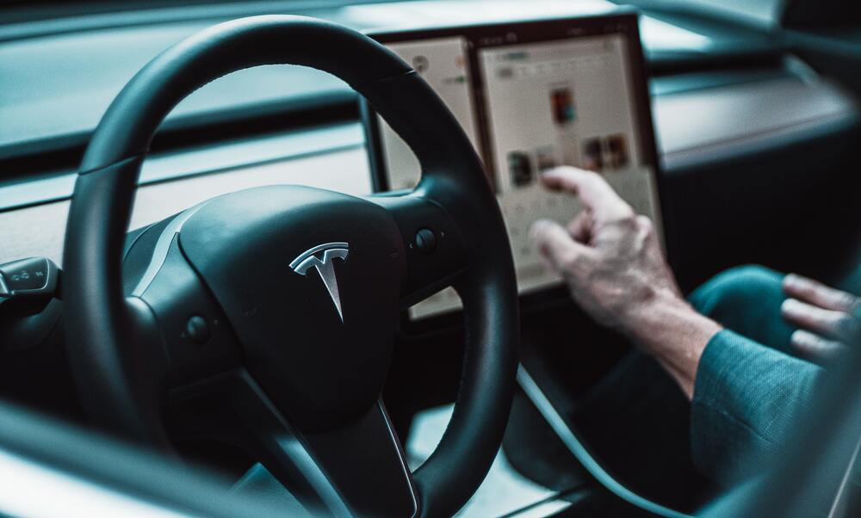
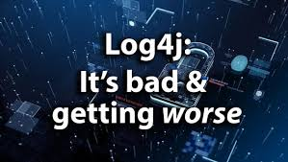
Why
In November, Tesla recalled close to 12,000 vehicles after discovering a glitch in its Full-Self Driving beta software. Following its most recent update on October 23, Tesla began receiving reports from customers reporting that their vehicles had falsely identified forward collision threats which had caused the automatic emergency braking (AEB) system to activate and bring the vehicle to a sudden stop.
The Log4j software bug has set the internet on fire after it has left millions of web servers vulnerable to hackers. The vulnerability was first discovered in the beginning of December. What makes this bug so terrifying is the fact that Log4j, an open-source logging library, is used by many companies worldwide, including high profile organizations like Apple, Amazon, Cisco, IBM, Microsoft, and many many more.

Slide 17
What
Let’s see how well you are
We want to design a program
The program reads three integers from an input box
The three integers represent three edges of a triangle
The program will tell you the triangle is scalene, isosceles or equilateral
3
3
3
Equilateral

Slide 19
What
Do you have a test case that represents a valid scalene triangle? (Note that test cases such as 1, 2, 3 and 2, 5, 10 do not warrant a yes answer because a triangle having these dimensions is not valid.)
Do you have a test case that represents a valid equilateral triangle?
Do you have a test case that represents a valid isosceles triangle? (Note that a test case representing 2, 2, 4 would not count because it is not a valid triangle.)
Do you have at least three test cases that represent valid isosceles triangles such that you have tried all three permutations of two equal sides (such as, 3, 3, 4; 3, 4, 3; and 4, 3, 3)?
Do you have a test case in which one side has a zero value?
Do you have a test case in which one side has a negative value?
Do you have a test case with three integers greater than zero such that the sum of two of the numbers is equal to the third? (That is, if the program said that 1, 2, 3 represents a scalene triangle, it would contain a bug.)

Slide 20
What
Do you have at least three test cases in category 7 such that you have tried all three permutations where the length of one side is equal to the sum of the lengths of the other two sides (e.g., 1, 2, 3; 1, 3, 2; and 3, 1, 2)?
Do you have a test case with three integers greater than zero such that the sum of two of the numbers is less than the third (such as 1, 2, 4 or 12, 15, 30)?
Do you have at least three test cases in category 9 such that you have tried all three permutations (e.g., 1, 2, 4; 1, 4, 2; and 4, 1, 2)?
Do you have a test case in which all sides are zero (0, 0, 0)?
Do you have at least one test case specifying non-integer values (such as 2.5, 3.5, 5.5)?
Do you have at least one test case specifying the wrong number of values (two rather than three integers, for example)?
How many “Yes” you got?
Average 7.8 for the professional programmers

Slide 21
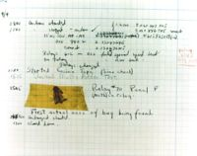
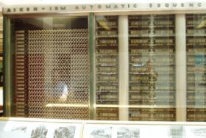
Introduction
What is a computer bug?
In 1947 Harvard University was operating a room-sized computer called the Mark II.
A moth flew into the computer and was zapped by the high voltage when it landed on a relay.
Hence, the first computer bug!

Slide 22
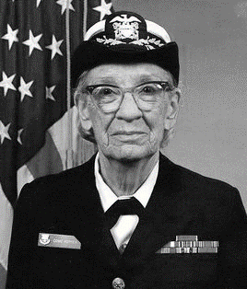
Introduction
Grace Hopper
Grace Brewster Murray Hopper was an American computer scientist and United States Navy rear admiral.
One of the first programmers of the Harvard Mark I computer, she was a pioneer of computer programming who invented one of the first linkers.
1906-1992

Slide 23
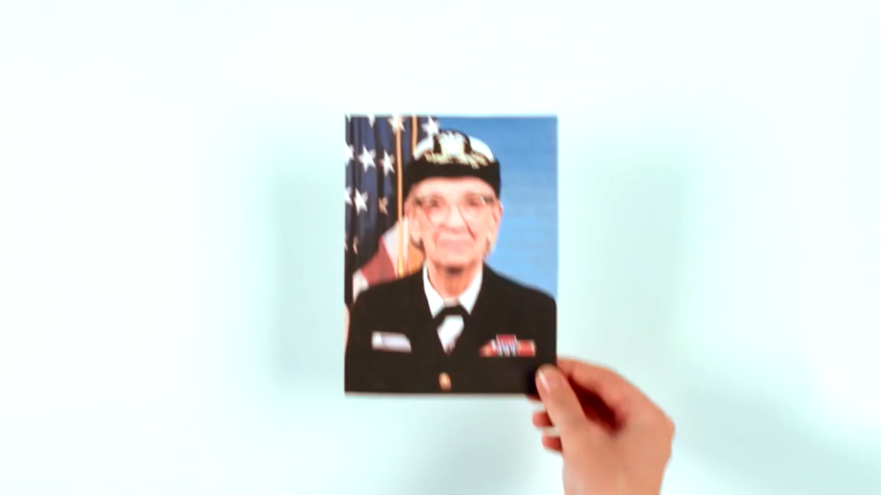
Introduction
Grace Hopper

Slide 24
Introduction
Bugs a.k.a. …
Defect
Fault
Problem
Error
Incident
Anomaly
Variance
Failure
Inconsistency
Product Anomaly
Product Incidence
Feature

Slide 25
Introduction
Fault, Error & Failure
Software Fault : A static defect in the software (i.e., defect)
Software Error : An incorrect internal state that is the manifestation of some fault
Software Failure : External, incorrect behavior with respect to the requirements or other description of the expected behavior

Slide 26
Introduction
Software Fault : A static defect in the software (i.e., defect, bug)
public static void CSta (int [ ] numbers)
{
int length = numbers.length;
double mean, sum;
sum = 0.0;
for (int i = 1; i < length; i++)//i=0
{
sum += numbers [ i ];
}
mean = sum / (double) length;
System.out.println ("mean: " + mean);
}
Fault

Slide 27
Introduction
Software Error : An incorrect internal state that is the manifestation of some fault
public static void CSta (int [ ] numbers)
{
int length = numbers.length;
double mean, sum;
sum = 0.0;
for (int i = 1; i < length; i++)//i=0
{
sum += numbers [ i ];
}
mean = sum / (double) length;
System.out.println ("mean: " + mean);
}
Test Input: [3,4,5]
Error
sum=3+4+5
sum=4+5

Slide 28
Introduction
Software Failure : External, incorrect behavior with respect to the requirements or other description of the expected behavior
public static void CSta (int [ ] numbers)
{
int length = numbers.length;
double mean, sum;
sum = 0.0;
for (int i = 1; i < length; i++)//i=0
{
sum += numbers [ i ];
}
mean = sum / (double) length;
System.out.println ("mean: " + mean);
}
Test Input: [3,4,5]
sum=3+4+5
sum=4+5
failure
mean=4
mean=3

Slide 29
Introduction
PIE Model
Execution/Reachability : The location or locations in the program that contain the fault must be reached
Infection : The state of the program must be incorrect
Propagation : The infected state must propagate to cause some output of the program to be incorrect

Slide 30
Introduction
A test executing the fault may not produce an error!
public static void CSta (int [ ] numbers)
{
int length = numbers.length;
double mean, sum;
sum = 0.0;
for (int i = 1; i < length; i++)//i=0
{
sum += numbers [ i ];
}
mean = sum / (double) length;
System.out.println ("mean: " + mean);
}
Test Input: [0,4,5]
sum=0+4+5
sum=4+5
Not an error for “sum”
mean=3
mean=3

Slide 31
Introduction
An error may not be propagated to the output!
public static void CSta (int [ ] numbers)
{
int length = numbers.length-1;
double mean, sum;
sum = 0.0;
for (int i = 0; i < length; i++)
{
sum += numbers [ i ];
}
mean = sum / (double) length;
System.out.println ("mean: " + mean);
}
Test Input: [3,5,4]
Error
sum=3+5+4
sum=3+5
mean=12/3=4
mean=8/2=4
No Failure
31

Slide 32
Introduction
Defective Software
We develop programs that contain defects
How many? What kind?
Hard to predict the future, however…it is highly likely, that the software we (including you!) will develop in the future will not be significantly better. ☹

Slide 33
To be continued… See you next week

